Slide 1
Quantitative Research Methods
Matthew Ivory
matthew.ivory@lancaster.ac.uk

Slide 2
1. Introduction to the course
Session 1: Introduction to quantitative research methods using R
Session 2: Data management and data wrangling
Session 3: Exploratory data analysis
Session 4: Data visualization
Session 5: Live Coding Walkthrough
Session 6: Probability and distributions
Session 7: Tests for discrete variables: Analysing contingency tables
Session 8: Correlations and t-tests.
Session 9: ANOVA and linear regression
Session 10: Multiple regression, introduction to generalised linear regression

Slide 3
In this session
ANOVA
One way ANOVA
Factorial ANOVA
Linear regression

Slide 4
ANalysis Of VAriance - ANOVA
ANOVA is used to test for significant differences between two or more conditions
Like carrying out multiple t-tests at the same time
When we conduct an ANOVA, we get a common p-value which gives an indication whether at least one pair’s difference in statistically significant
We then conduct further post-hoc tests to test which groups are different

Slide 5


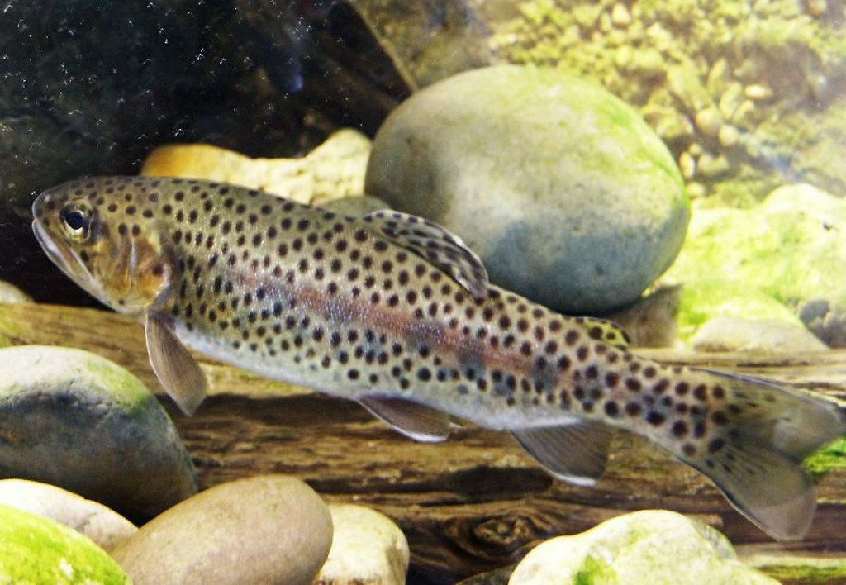

ANalysis Of VAriance - ANOVA
We measure the length of trout at three spots in a water system, one where the water moves fast, slow, and still.
We want to know if their length is different in these different conditions
This Photo by Unknown Author is licensed under CC BY-NC-ND
This Photo by Unknown Author is licensed under CC BY-NC-ND

Slide 6
ANalysis Of VAriance - ANOVA
We measure the length of trout at three spots in a water system, one where the water moves fast, slow, and very slow.
We want to know if their length is different in these different conditions.
We believe that faster fish are better suited for faster water because they are not washed away
We hypothesise that fish length in slower moving water will be greater than fish from faster flowing water

Slide 7
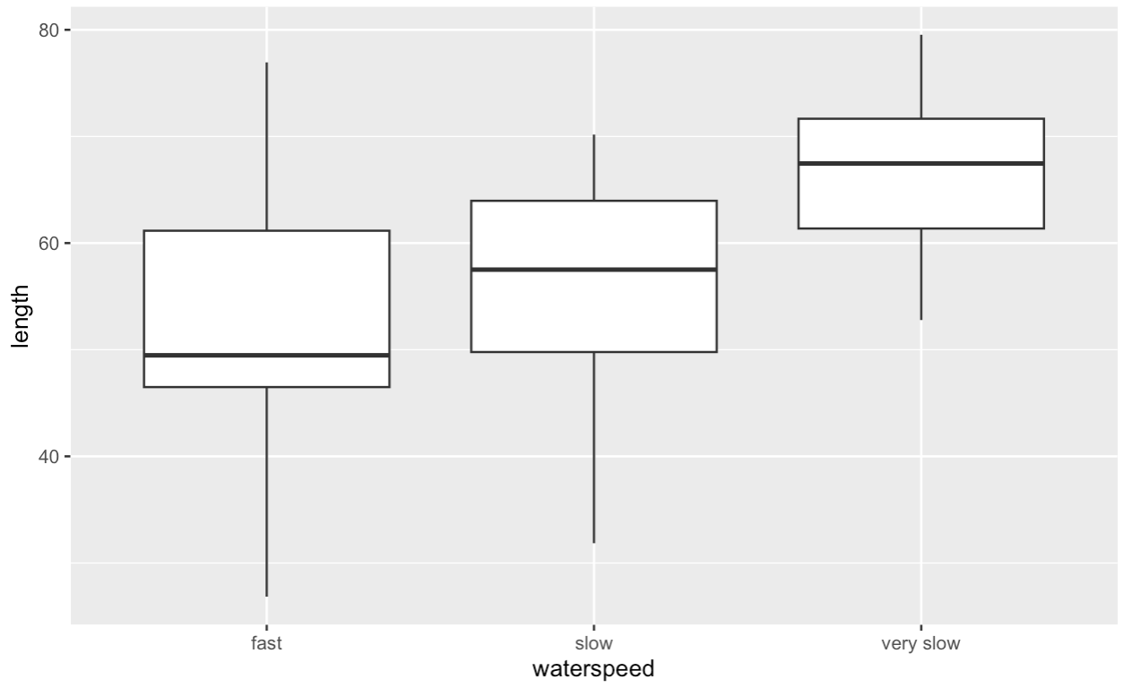
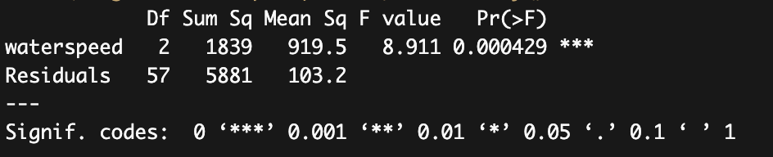
ANalysis Of VAriance - ANOVA
We hypothesise that fish length in slower moving water will be greater than fish from faster flowing water
Our degrees of freedom, and we report both
(2, 57)
The statistic from the ANOVA
It’s significance. Using the codes below
The p-value
P < .001, but what are the pairwise comparisons?
The differences between the conditions

Slide 8
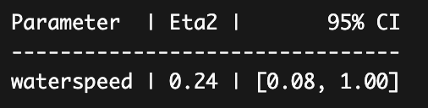
ANalysis Of VAriance – ANOVA Effect size
We hypothesise that fish length in slower moving water will be greater than fish from faster flowing water
The confidence interval (bounded by 1 at the top
Our effect size
.24
P < .001, and eta-squared is .24, but what are the pairwise comparisons?
The differences between the conditions

Slide 9
Post-hoc tests and Multiple Comparisons
When we run multiple tests, it is easy to ignore just how many are being tested
Multiple comparisons arise when a statistical analysis involves multiple simultaneous statistical tests, each of which has a potential to produce a “discovery.”
The more tests we carry out, the more pairs we are testing…
1
3
6
10, 15, 21,…

Slide 10
Post-hoc tests and Multiple Comparisons
So much so that in a room of just 23 people, there is a ~50:50 chance that two people share a birthday.
Each person makes 22 comparisons, meaning 253 comparisons are made
The odds of NOT sharing a birthday are 364/365, or 99.726%
With 253 comparisons there is a 49.952% chance no one matches.
1
3
6
10, 15, 21,…

Slide 11
Post-hoc tests and Multiple Comparisons
The same stands for statistical tests, because we are still dealing with probabilities
We need to account for these comparisons, and increased likelihood of a false positive (or type I error)
We can use the Bonferroni correction
This states that we divide our initial p-value by the number of comparisons.
So for an original threshold of .05, the corrected threshold is now more conservative at .05/3 or 0.01666667
We can also report a mathematical equivalent (that keeps the threshold the same) by multiplying our original p-value by the number of comparisons

Slide 12

Post-hoc tests and Multiple Comparisons
We can also report a mathematical equivalent (that keeps the threshold the same) by multiplying our original p-value by the number of comparisons
We can use pairwise_t_test for making these comparisons and to automatically conduct our adjustments
Significance
The groups being compared
Original p value
(not important)
New p value
(important)

Slide 13
ANOVA Assumptions
An ANOVA can only be conducted if there is no relationship between the subjects in each sample. This means that subjects in the first group cannot also be in the second group (e.g., independent samples/between groups).
The different groups/levels must have equal sample sizes.
An ANOVA can only be conducted if the dependent variable is normally distributed so that the middle scores are the most frequent and the extreme scores are the least frequent.
Population variances must be equal (i.e., homoscedastic). Homogeneity of variance means that the deviation of scores (measured by the range or standard deviation, for example) is similar between populations.

Slide 14
ANOVA is just a special case of …

Slide 15
ANOVA is just a special case of the linear model!
Despite ANOVA being equivalent to a linear regression (and can be designed and interpreted as such) – it is important to understand how to conduct and use an ANOVA anyway, because they are widely used
You may come across these tests in your literature reviews, and so it is useful to know what they are.
Personally, I would encourage you to always defer to a linear regression over an ANOVA because you have greater control and development over more complex models
You may also come across ANOVA, ANCOVA, MANOVA…, they all form some special case of the linear regression and in fact MANOVA is multiple regression (week 10)

Slide 16
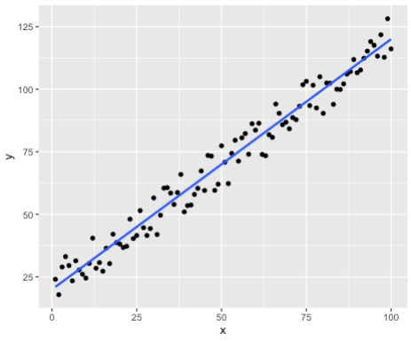
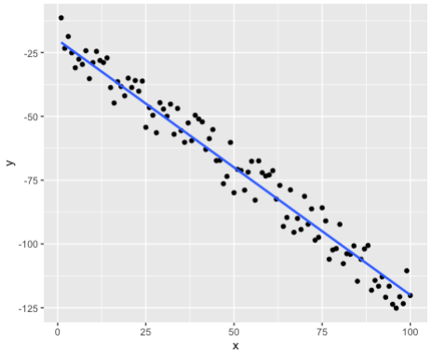
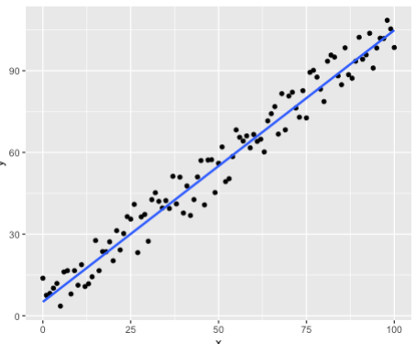
The linear model!
The linear model in its simplest form is Y = mX + c
Where we can describe variable Y as a function of X multiplied by some slope (m) and a constant (c)
We use linear regression to “model” a variable using others
We assume a linear relationship exists between the variables (as one increases, so does the other)

Slide 17
The linear model
Y = mX + c
M = 1 means that for every unit increase in X, Y increases by 1. The higher m is, the steeper the line
C in the example below is ~5 because when X is zero, then Y = 0 + c
C is a constant term and can be made up of more than one term e.g., error, minimum theoretical values
Notes:
Getting height and weight on newborns – cannot be zero. We cannot have a baby with zero height or weight.

Slide 18
Linear regression plots look a lot like correlation…
Yes, but they are not. Correlations go both ways, X~Y and Y~X
Regression models are predictive, we have a predictor (independent variable) and our dependent variable
We model the outcome data based on the inputs, and we can say more concretely that X predicts Y, or Y is predicted by X.
“Time spent studying predicts exam success”
Two different tests

Slide 19
We rarely see perfectly linear relationships
But they offer a way to model behaviours/outcomes with other data
We can use the regression model to predict future data

Slide 20
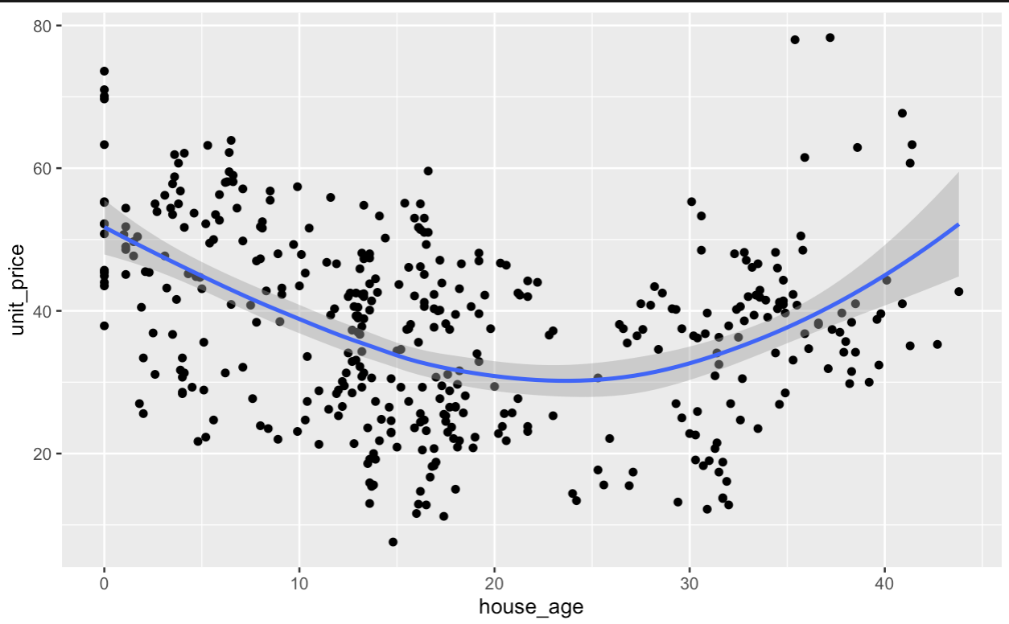
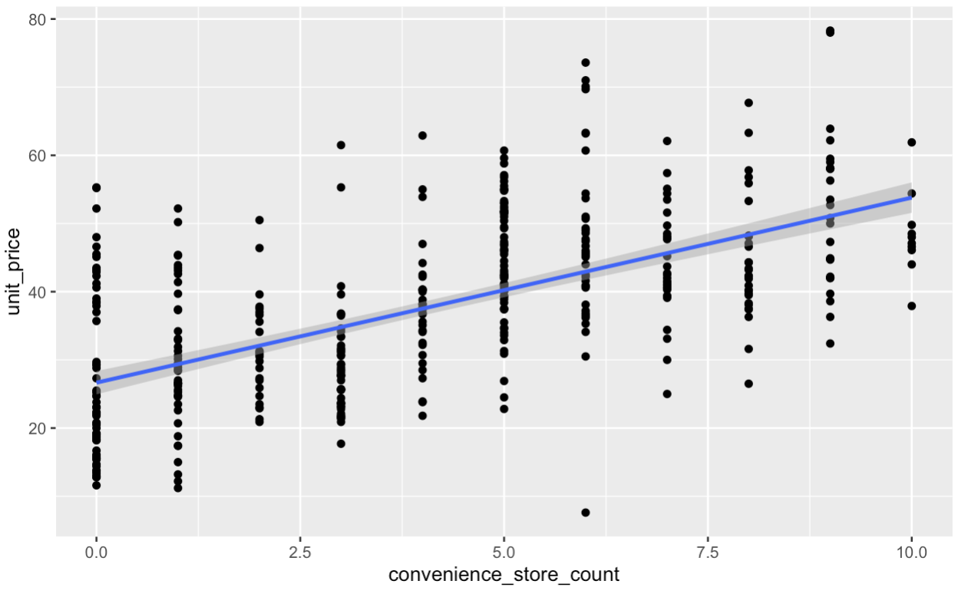


An example analysis
Let us look at house prices in Taiwan
Specifically two questions: does house age or shop proximity influence house price?

Slide 21
An example analysis
Let us look at house prices in Taiwan
Specifically one questions: does shop proximity influence house price?

Slide 22
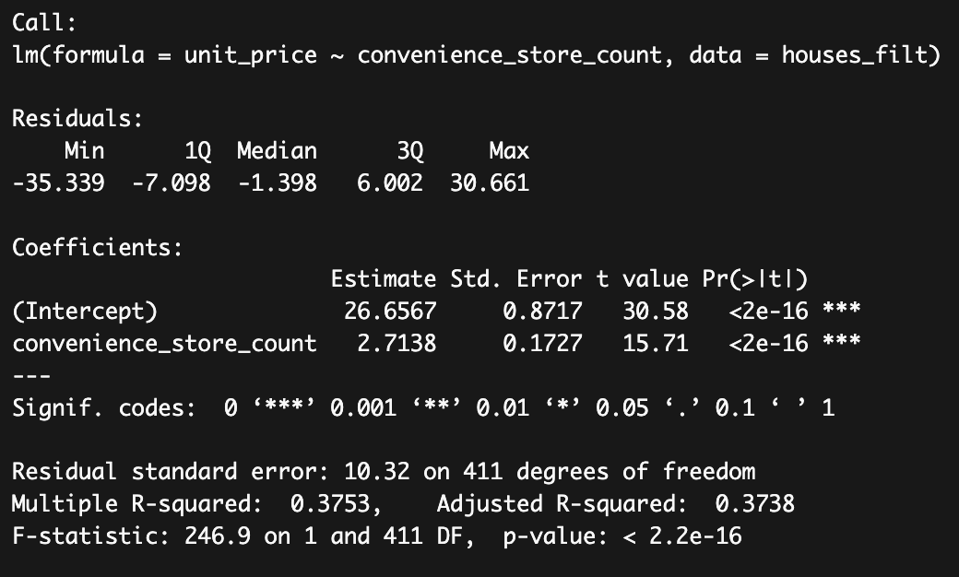
An example analysis
Our residuals – they should be roughly centred evenly around zero
The test statistic for each coeff
Our formula
Our p-value
Our predictor significance
Our y coefficient
Our x coefficient
R² – the explained
variance
The regression test statistic
Both degrees of freedom
Our model significance

Slide 23
An example analysis
So for every unit increase in store count, we see an increase in house price by 2.71
Or,
For every additional store in the area, house prices increase significantly by 27,100 Taiwan $ (variable measured in 10,000 NTD)
37.38% of price variance is explained by the number of stores present.
Effect sizes (f²) are detailed in the worksheet but = .60 which is large. This is a meaningful predictor
Notes:
~ £250 today

Slide 24
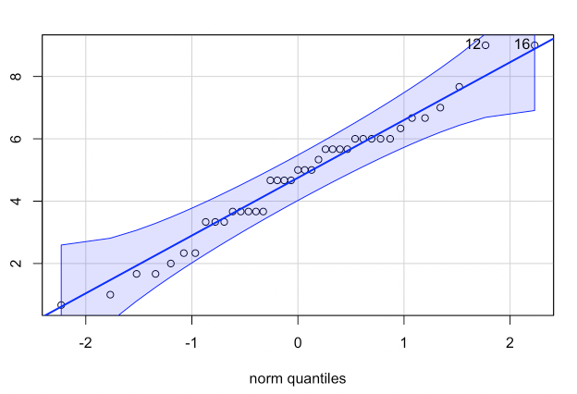
Assumption testing beyond eyeballing
We touched on homoscedasticity last session, but it requires a more focused exploration here, as does testing the assumption of normality
Normality
We looked at this last week with QQ plots.
If it follows the diagonal, we considered it suitable
We assumed that the data was a decent proxy for this assumption
There are more rigorous ways test normality…

Slide 25
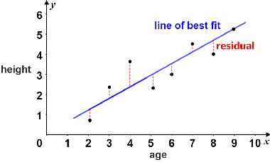
Testing for Normality
The normality assumption is that residuals follow a normal distribution
Last week we used the data itself as a proxy for residuals
Residuals are the difference between the predicted values (from an ANOVA or regression, etc.) and the actual values of the response variable
We can use plots of the data and output (eyeballing), which IS good for normality
We can also use Shapiro-Wilks test in addition (more in the worksheet)

Slide 26
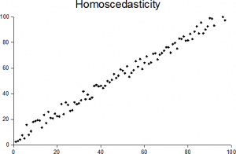
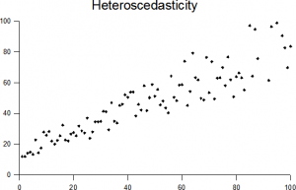
Testing for Homoscedasticity
Might be called homogeneity of variance too
It assumes that the noise is distributed evenly across the data (or if we plot the data, there is equal scatter across the plot)
There are two tests that can be used
Bartlett’s test for homogeneity of variances
Levene’s test (good for non-normal distributions)
They work more or less the same in R

Slide 27
Questions?
I will be walking around while you work through the worksheet

